Slide 1
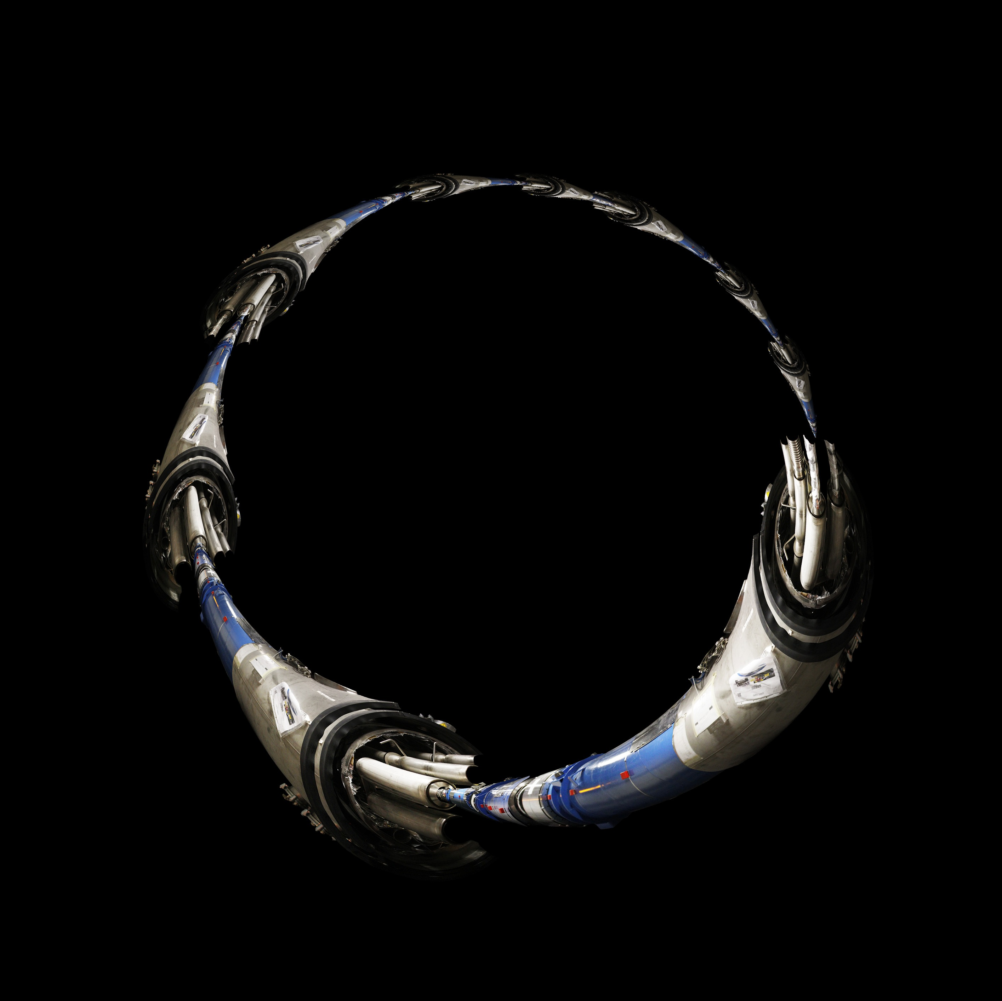
LHC Operation: Past and Future – part 1
Chris Henschke
After a successful first running period, LHC is now well into a two year shutdown for extensive consolidation. A pedagogical overview of the machine, its operating principles, its systems and underlying accelerator physics is presented. Performance past and future is discussed. (These lectures will be presented in three parts.)
Mike Lamont
with acknowledgements to all the people whose material I’ve used
(including Ralph Assmann, Luca Bottura, Heiko Damerau, Bernhard Holzer, Rende Steerenberg, Ralph Steinhagen, Jorg Wenninger...)

Slide 2
Contents
Base
  Magnets, cryogenics, QPS
  Optics etc.
  Beam (injectors, LHC)
  Crossing angles, squeeze…
  RF, Instrumentation
Pulling it together
  The nominal cycle
  Machine protection
Performance
  Past performance
  Limitations
  LS1
  The future and beyond

Slide 3
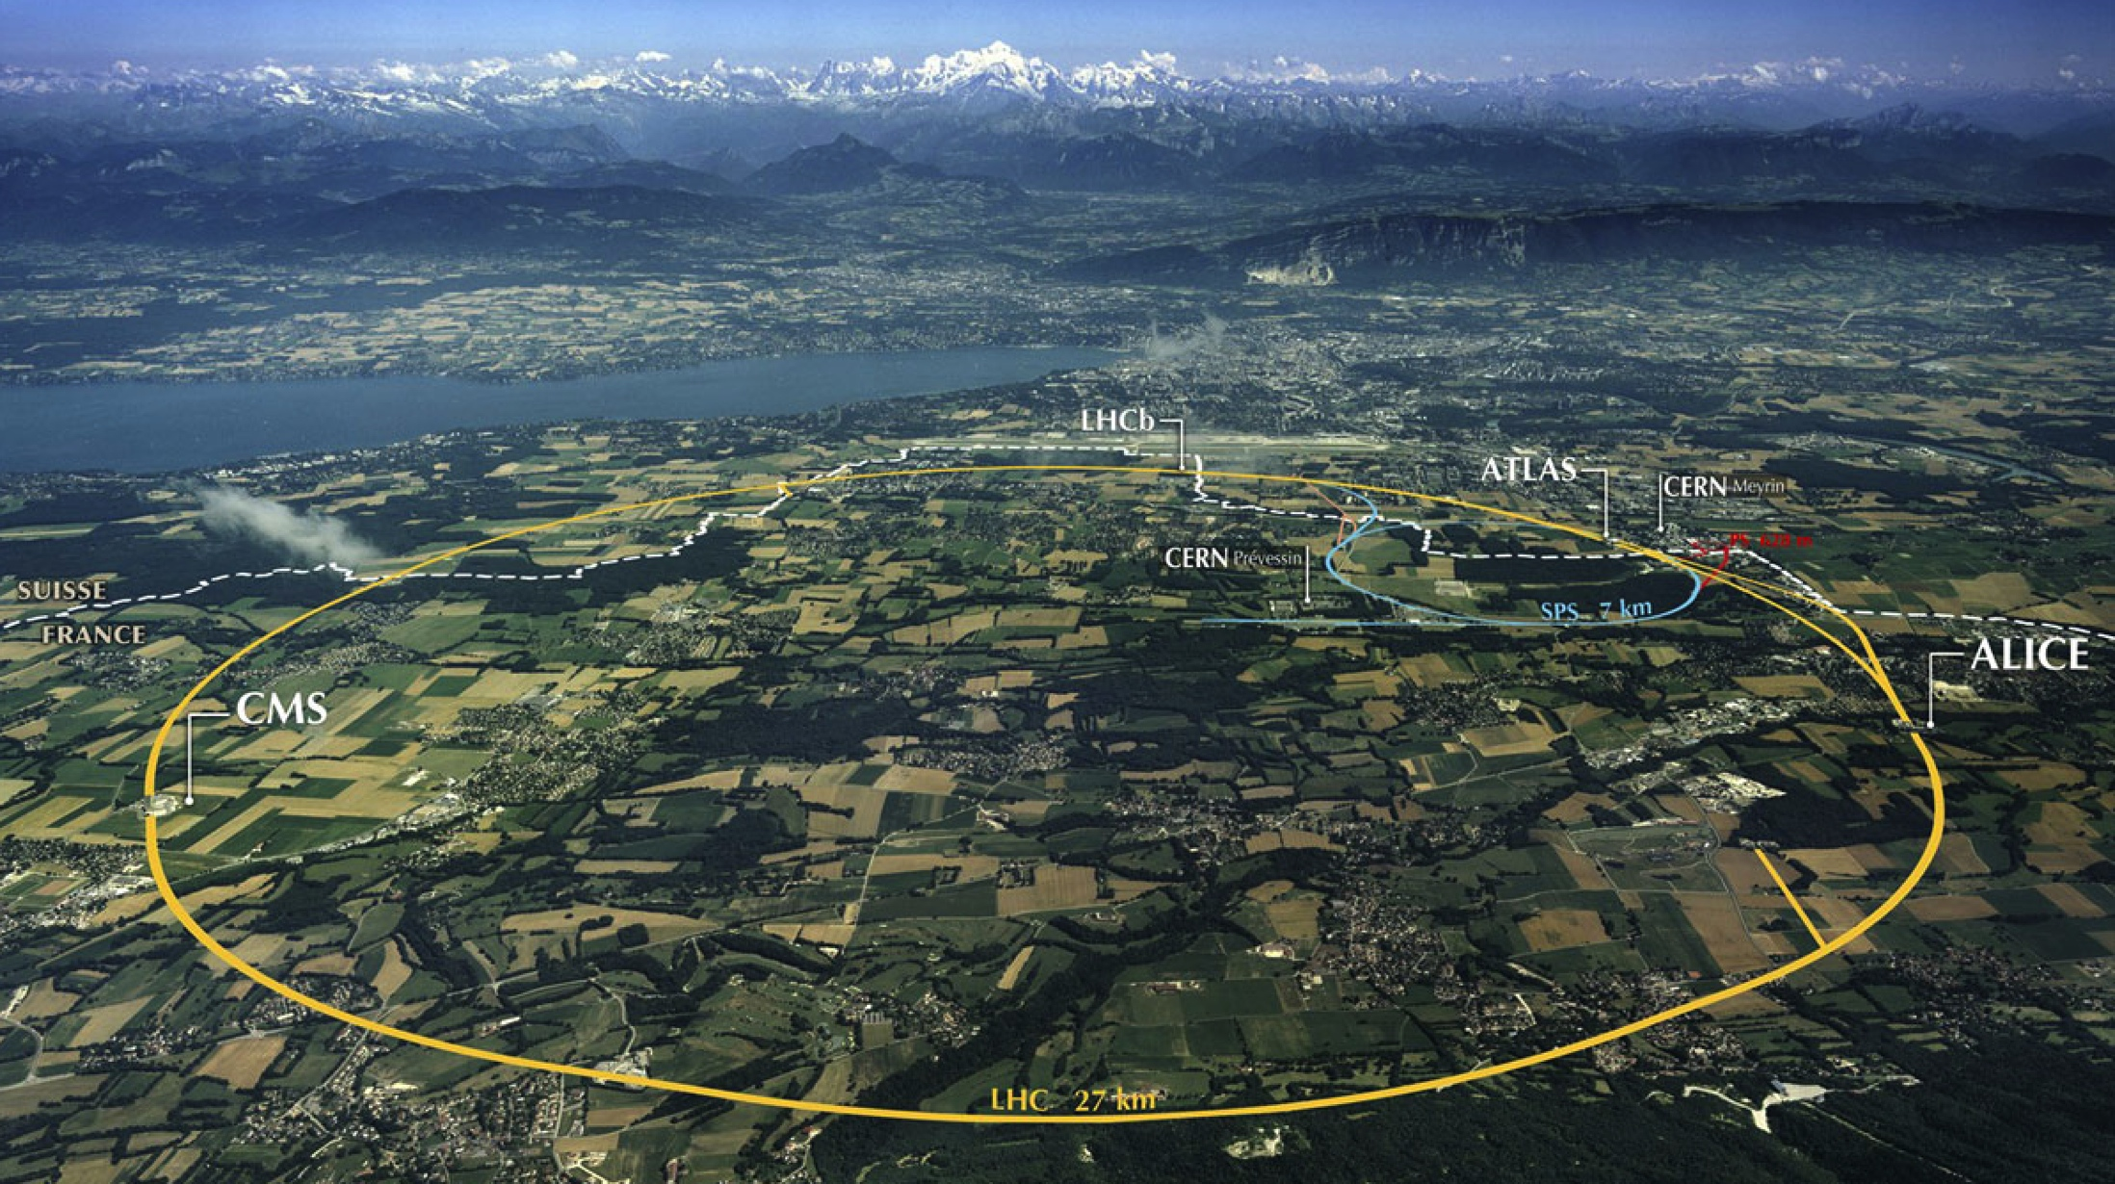
LHC: big, cold, high energy
Collimation
Injection B2
Beam dumps
Injection B1
Collimation
RF
1720 Power converters
> 9000 magnetic elements
7568 Quench detection systems
1088 Beam position monitors
~4000 Beam loss monitors
150 tonnes Helium, ~90 tonnes at 1.9 K
140 MJ stored beam energy in 2012
450 MJ magnetic energy per sector at 4 TeV

Slide 4
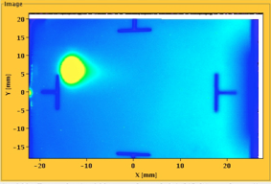
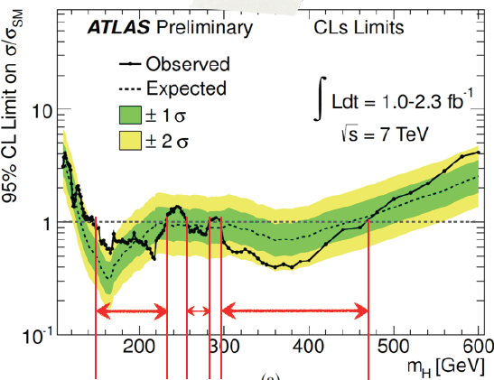
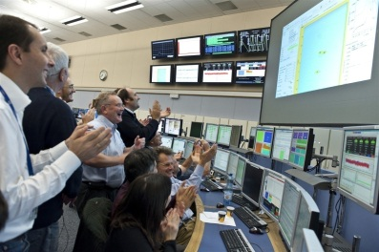


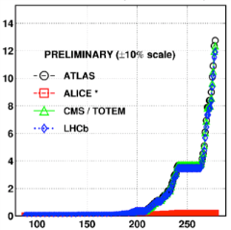

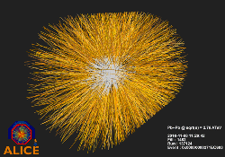
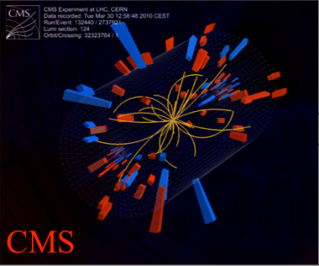
August 2008
First injection test
November 29, 2009
Beam back
August, 2011
2.3e33, 2.6 fb⁻¹
1380 bunches
September 10, 2008
First beams around
June 28 2011
1380 bunches
October 14 2010
1e32
248 bunches
4 July, 2012
1380
6 June, 2012
6.8e33
2008
2009
2010
2011
2012
November 2010
Ions
March 30, 2010
First collisions at 3.5 TeV
September 19, 2008
Disaster
Accidental release of 600 MJ stored in one sector of LHC dipole magnets
18 June, 2012
6.6 fb⁻¹
to ATLAS & CMS
LHC Timeline

Slide 5
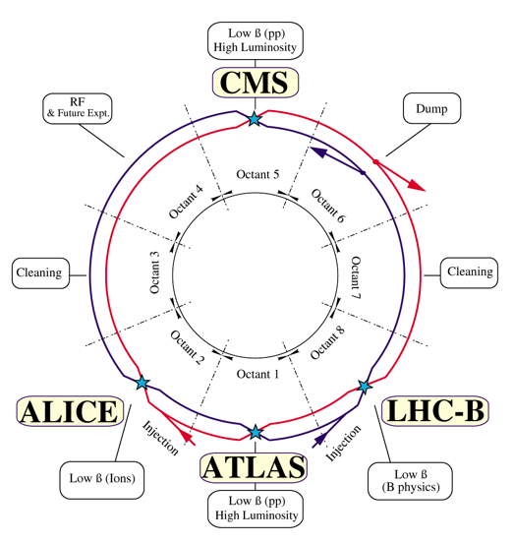
LHC – principles & reality
High energy
High luminosity
High availability
High energy
High bunch intensity
Many bunches
Small beam size
Superhuman operations team
LEP tunnel defines the bending radius
Superconducting magnet technology
1.9 K cryogenics
Bending radius & achievable field strength -> 7 TeV/c
Two beam pipes - 2 in 1 magnet design
Separated function - strong focusing
Luminosity insertions
Injectors

Slide 6
Superconductivity
To produce the high magnetic fields we need very high currents…
Make use of the remarkable properties of He II
Superfluid helium:
  Very high thermal conductivity (3000 time high grade copper)
  Very low coefficient of viscosity… can penetrate tiny cracks, deep inside the magnet coils to absorb any generated heat.
  Very high heat capacity…stablizes small transient temperature fluctuations
How many Bose-Einstein condensates are there in the LHC?

Slide 7

Video 1’44’’

Slide 8
Phase diagram of Helium

Slide 9
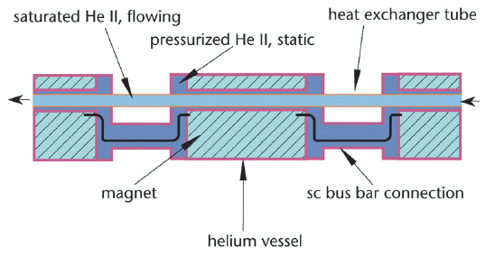
Cooling magnets with superfluid helium

Slide 10
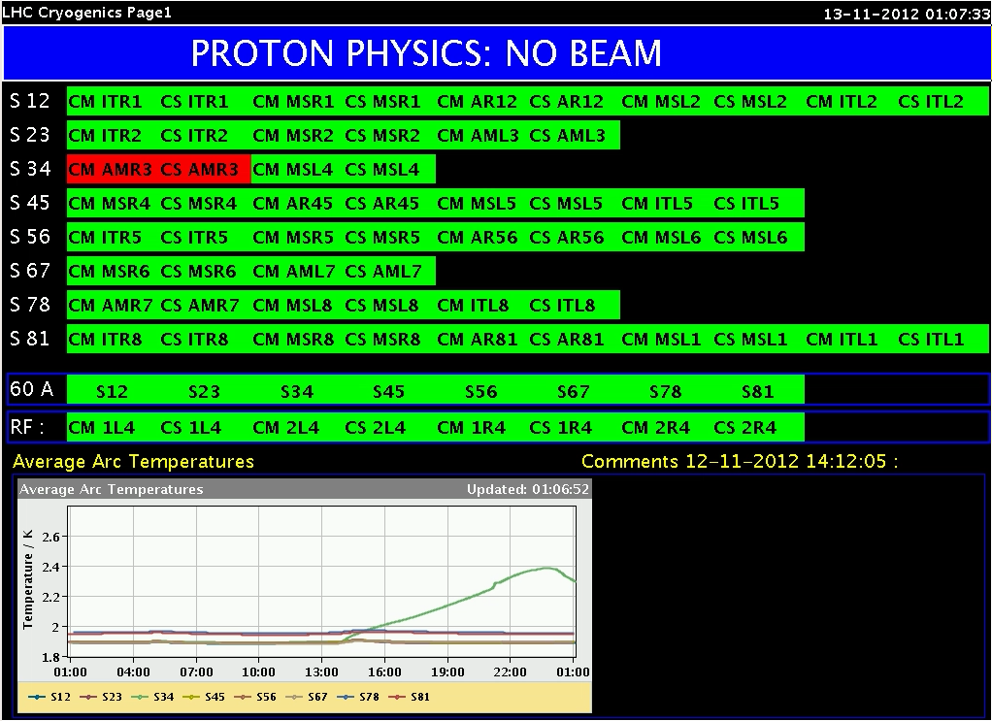
Operation prerequisite 1:
90 tonnes He II
Cryogenics system availability in 2012: 93.7%

Slide 11
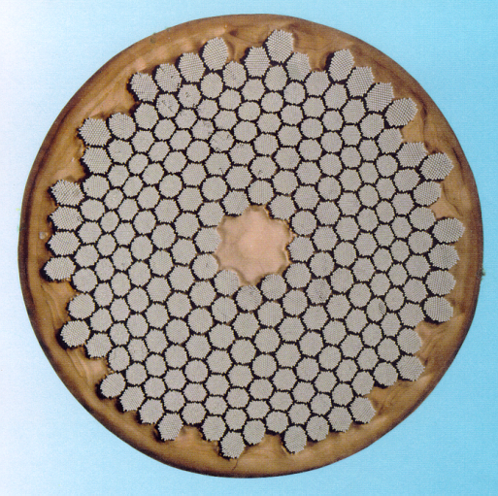
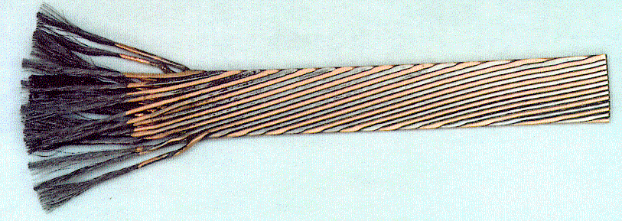
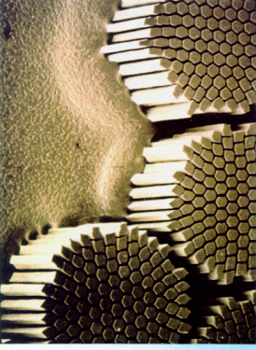
The superconductor
Niobium-titanium Rutherford cable
Strand
Cable
Filament
Used 1200 tonnes/7600 km of cable

Slide 12
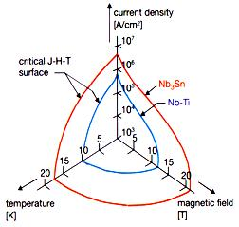
Critical surface of niobium-titanium
Niobium-titanium NbTi is the standard ‘work horse’ of the superconducting magnet business
Picture shows the critical surface, which is the boundary between superconductivity and normal resistivity
Superconductivity prevails everywhere below the surface, resistance everywhere above it
Temperature (K)
Field (Tesla)
Current density (kA.mm⁻²)
Notes:
All superconducting accelerators built so far have used niobium titanium.

Slide 13
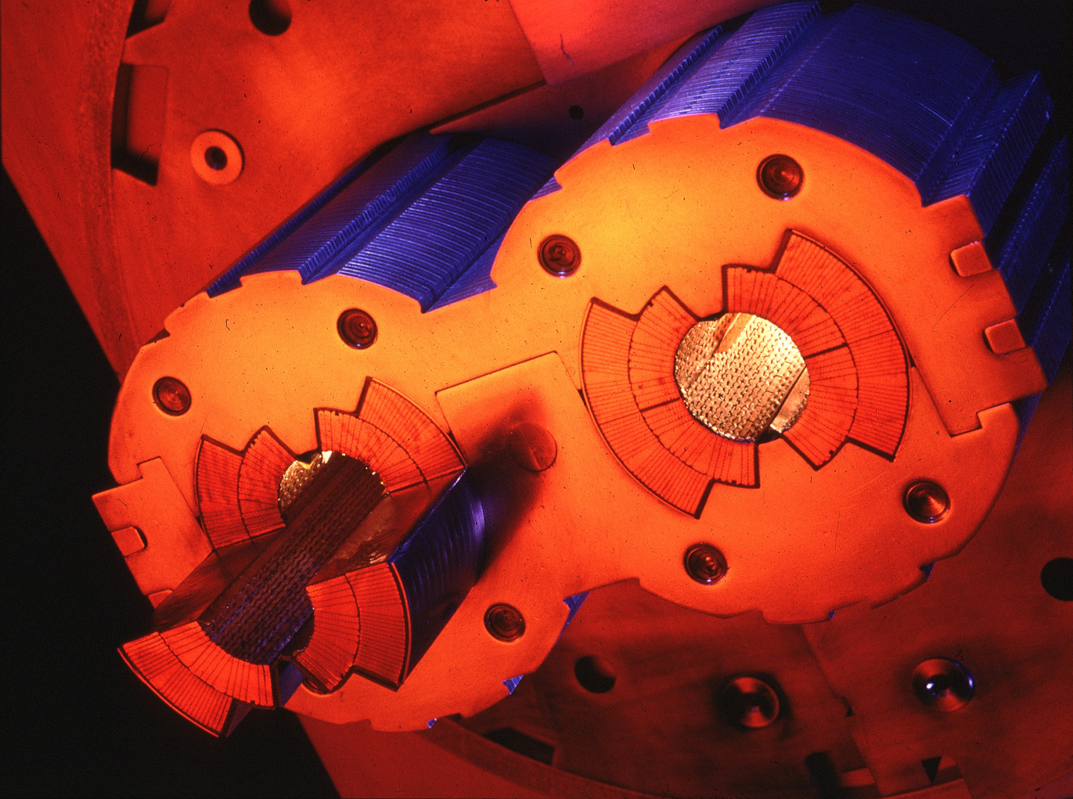
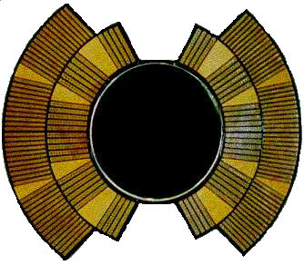
Main components – dipole magnets
I
I
I
B

Slide 14
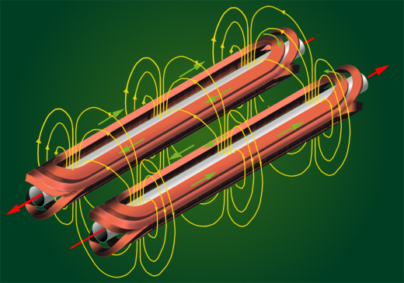
Number of dipoles 1232
Dipole field at 450 GeV 0.535 T
Dipole field at 7 TeV 8.33 T
Bending radius 2803.95 m
Main Dipole Length 14.3 m
Horizontal force component per quadrant (nominal field) 1.7 MN/m
Force tends to “open” the magnet, hence the Austenitic steel collars

Slide 15
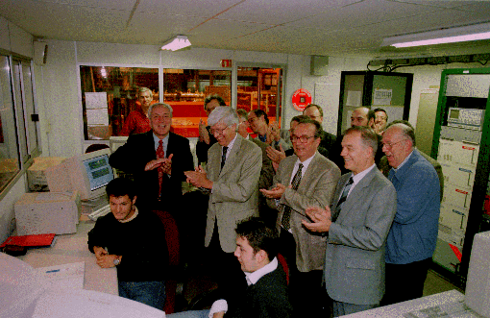
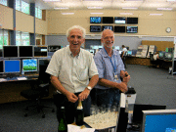
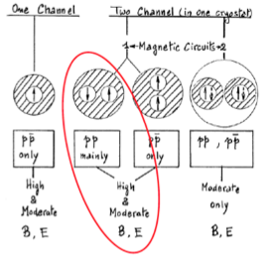
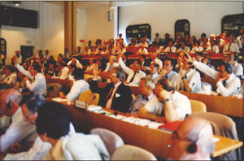
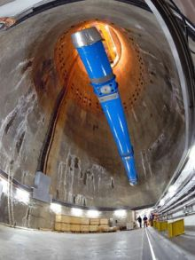
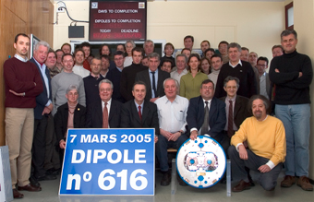
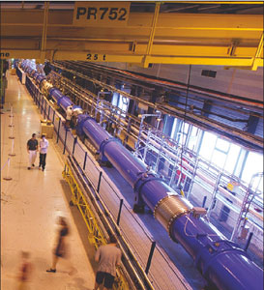

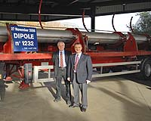
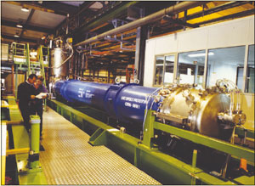
June 1994
first full scale prototype dipole
June 2007 First sector cold
ECFA-CERN workshop
April 2008
Last dipole down
1994 project approved by council (1-in-2)
SSC cancelled
Main contracts signed
1984
90
91
92
93
94
95
96
97
98
99
00
01
02
03
04
05
06
07
08
09
10
2002 String 2
November 2006
1232 delivered
First set of twin 1 m prototypes
Over 9 T
September 19, 2008

Slide 16
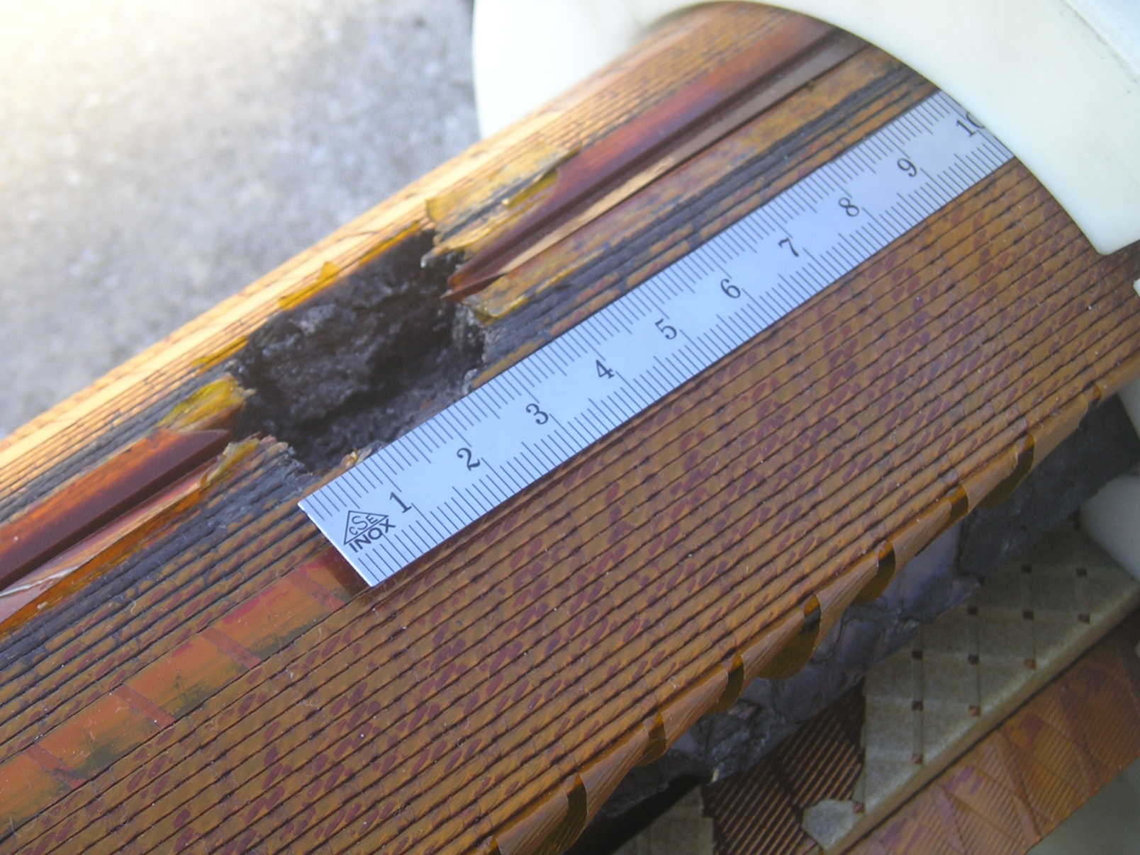
Energy stored in the magnets: quench
Quench protection: if not fast and reliable…
During magnet test campaign, the 7 MJ stored in one magnet were released into one spot of the coil (inter-turn short)
P. Pugnat

Slide 17
Quench - discharge of the energy
Power Converter
Discharge resistor
Magnet 1
Magnet 2
Magnet 154
Magnet i
Protection of the magnet after a quench:
The quench is detected by measuring the voltage increase over coil.
The energy is distributed in the magnet by forced quenching using quench heaters.
The current in the quenched magnet decays in < 200 ms.
The current flows through the bypass diode (triggered by the voltage increase over the magnet).
The current of all other magnets is discharged into the dump resistors.

Slide 18
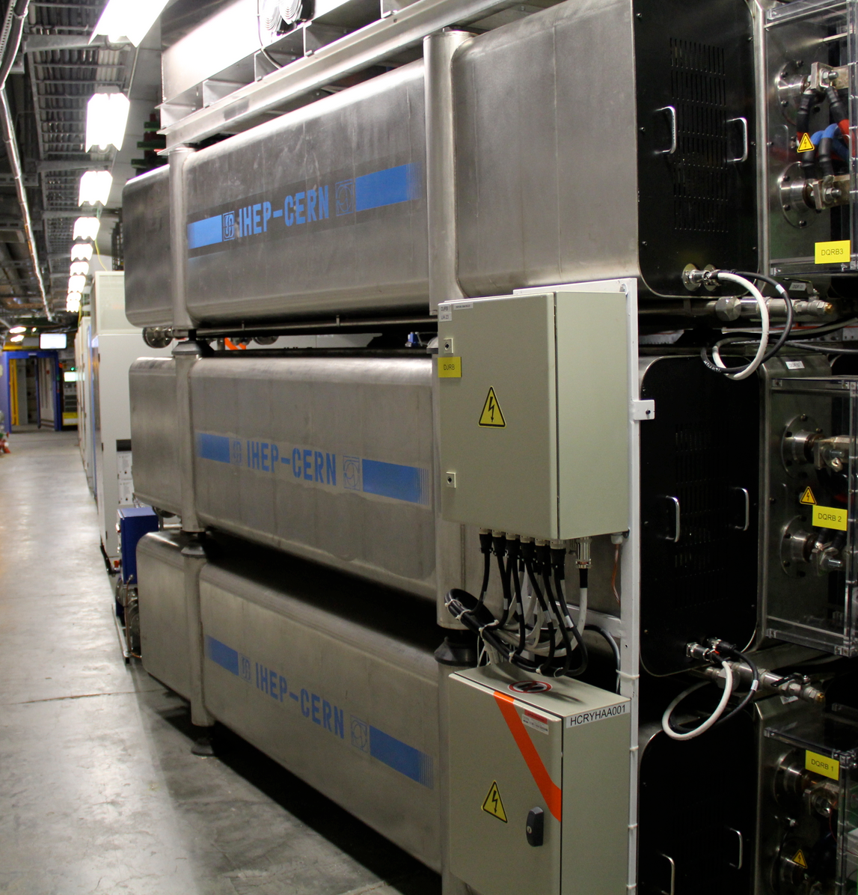
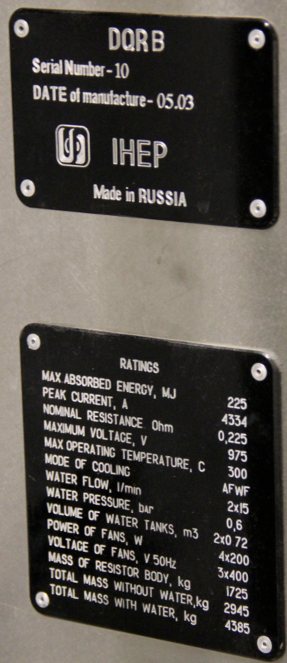

Slide 19
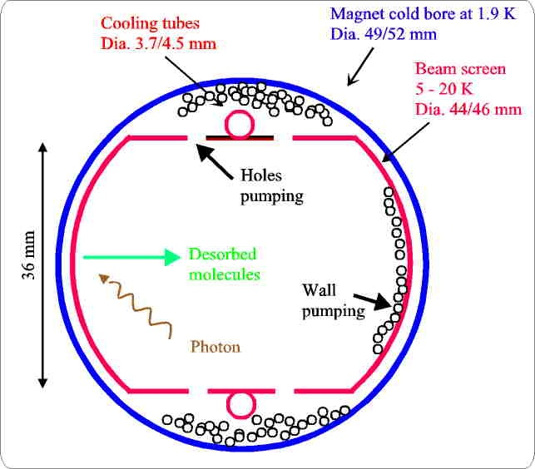
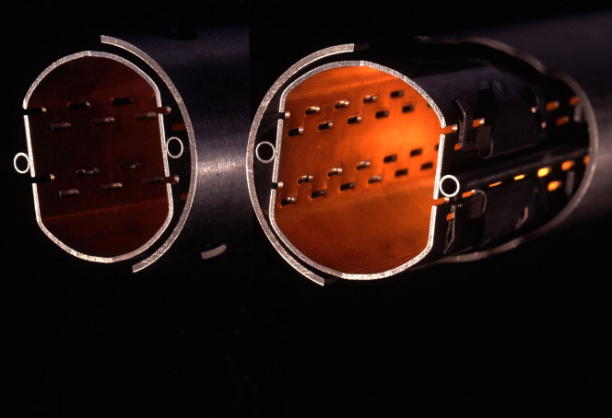
Vacuum
Beam vacuum ~10⁻¹⁰ mbar (~3 million molecules/cm³)
Cold
  Pumping is insured by cold surfaces for all gases except helium. To avoid subsequent desorption, low initial pressures are required before cool-down, and this is ensured by turbo molecular pumps etc.
Warm
  NEG provides most of the pumping capacity, with additional ion pumps for the noble gases which are not pumped by the NEG

Slide 20
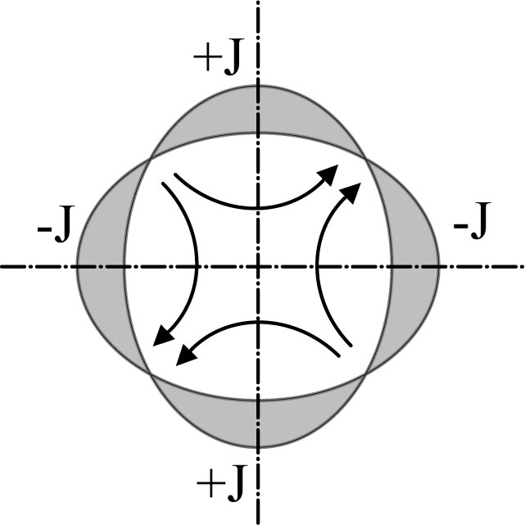
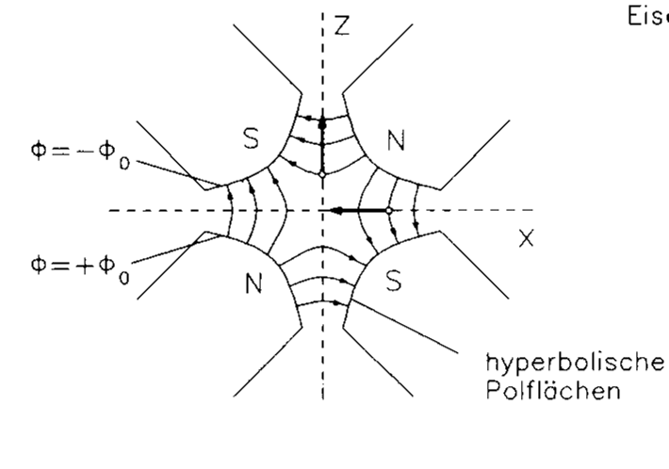
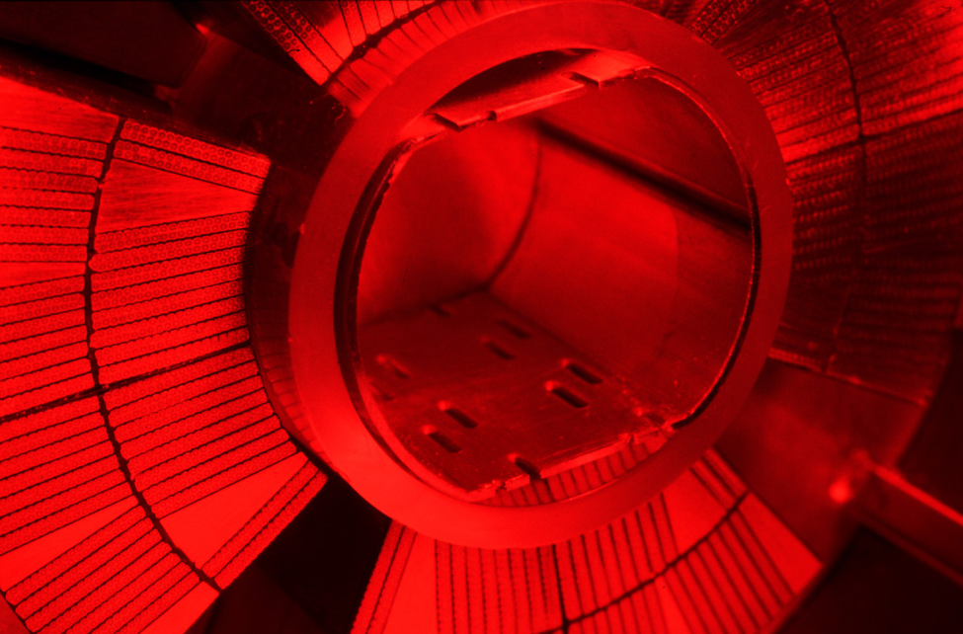
OPTICS
Recall: a quadrupole magnet will focus in plane and de-focus in the other.
Convention: a “focusing” quadrupole focuses in the horizontal plane

Slide 21
Alternate gradient focusing
x
s
The general linear magnet lattice can be parameterized by a ‘varying spring constant’, K=K(s).
K(s) describes the distribution of focusing strength along the lattice and is periodic.
(and similarly for the vertical plane y)
This is Hill’s equation.

Slide 22
Betatron oscillations
The solution to Hill’s equation.
Oscillatory term
Amplitude term
A and ₀ are constants, which depend on the initial conditions.
(s) = the amplitude modulation due to the changing focusing strength.
(s) = the phase advance, which also depends on focusing strength.
The amplitude and phase advance are both modulated by the beam envelope function, β.
x
s

Slide 23
β function
Put the assumed solution into Hill’s equation and turn the handle…
β(s) maybe interpreted as the local wavelength of the oscillation (divided by 2π)
define the envelopes in x and y of all the particle trajectories (all φ₀) with amplitude value A.
depend not only on the local focusing, K_{x,y}(s₀), but also on the focusing strength K_{x,y}(s) around an entire period of the lattice.

Slide 24
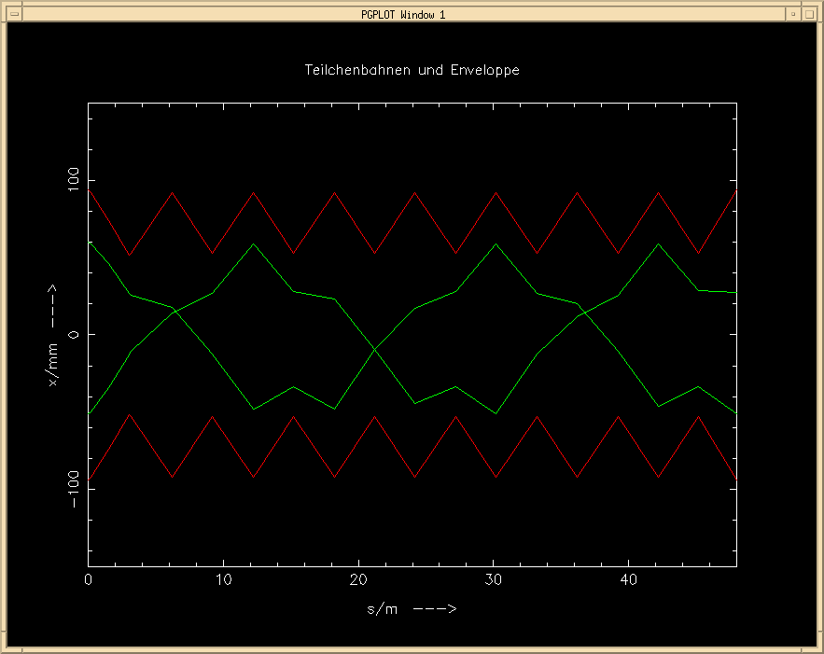
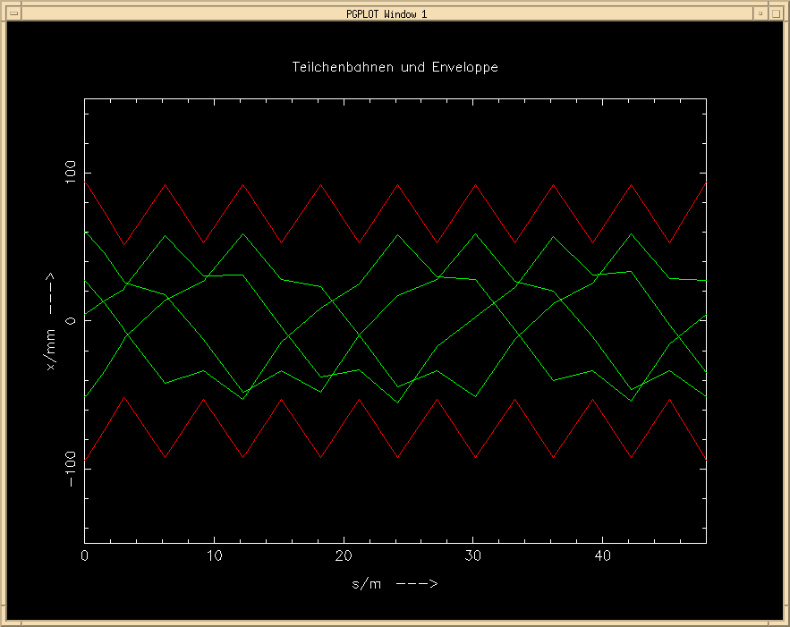
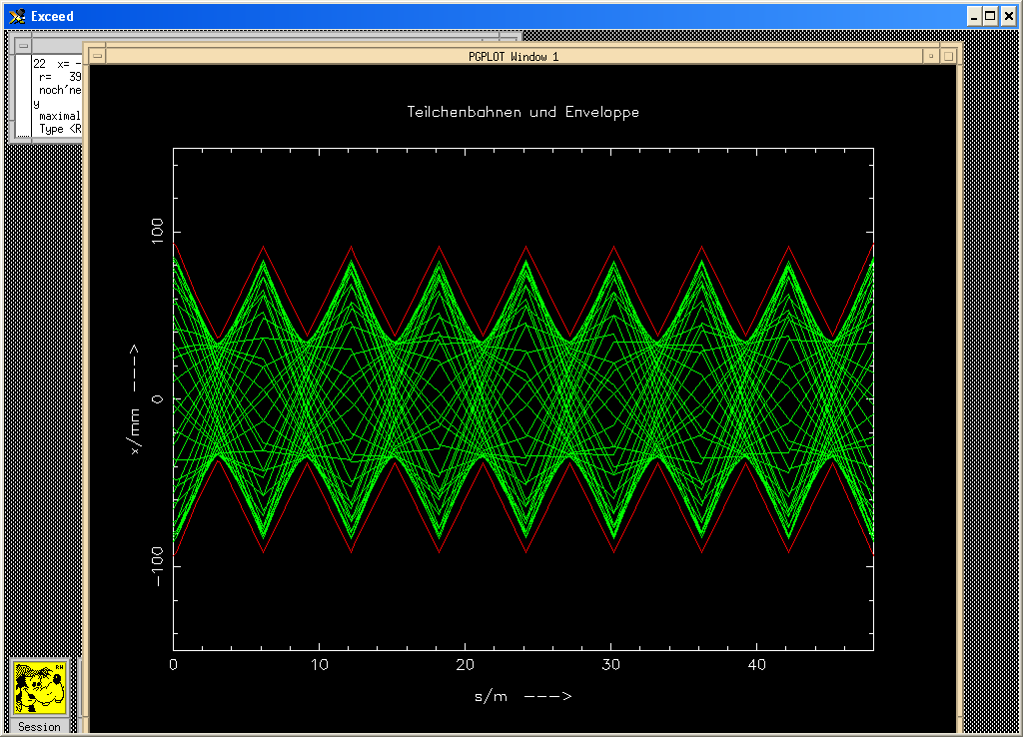
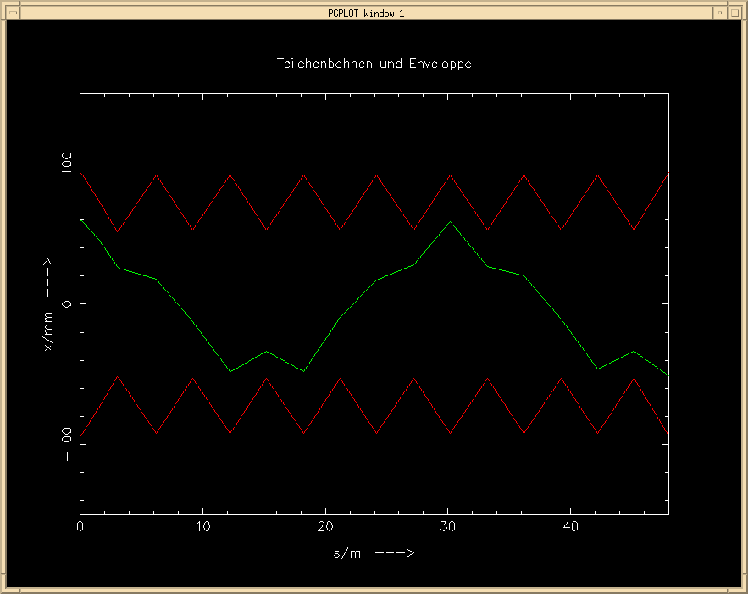
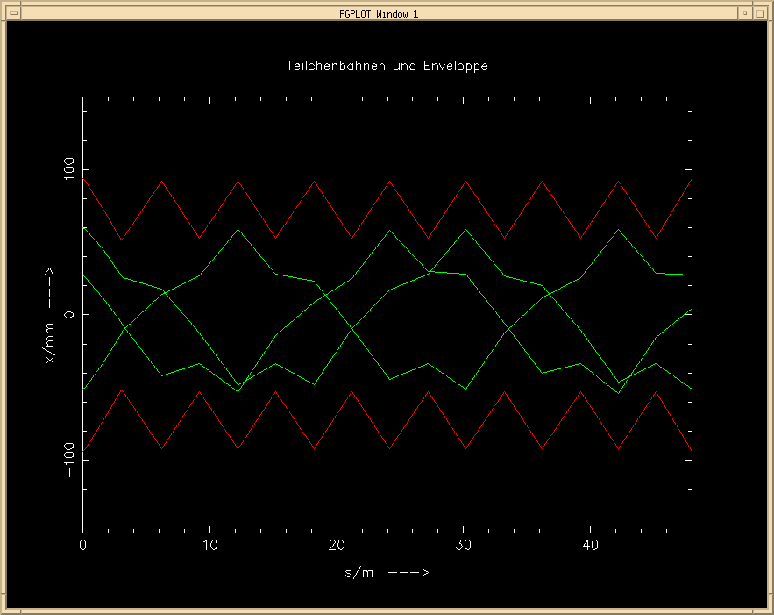
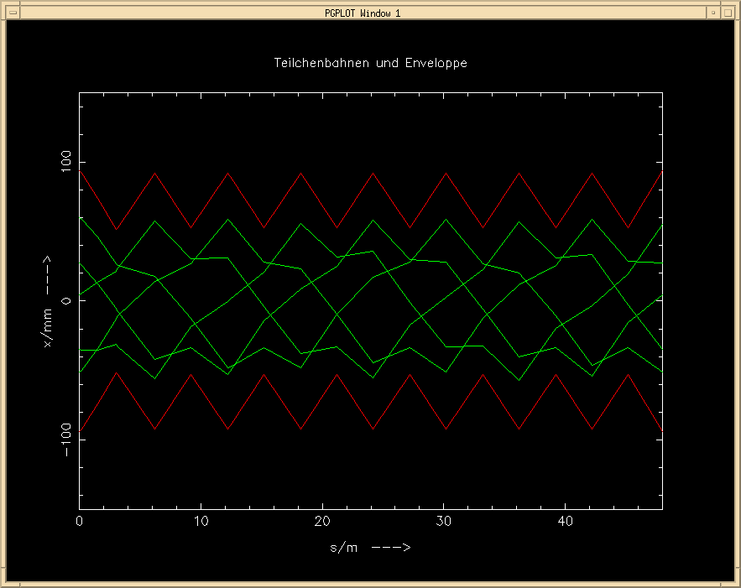
Question: what will happen, if the particle performs a second turn ?
... or a third one or ... 10¹⁰ turns
x
0
s
Bernhard Holzer

Slide 25
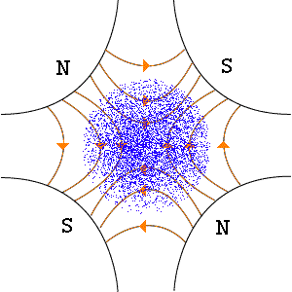
Amplitude modulation

Slide 26
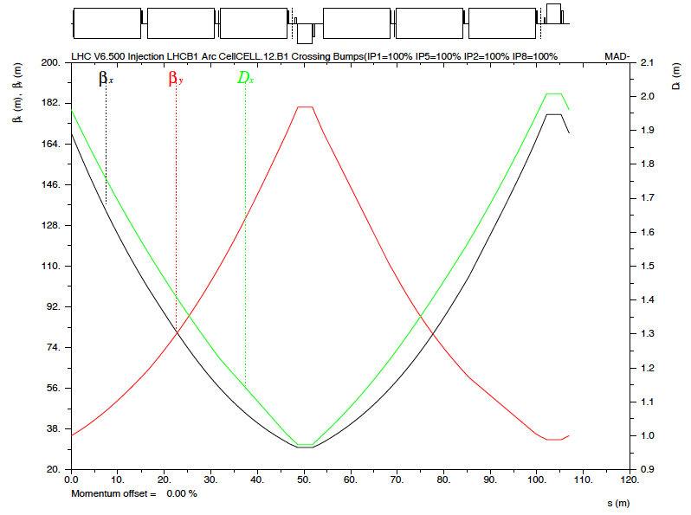
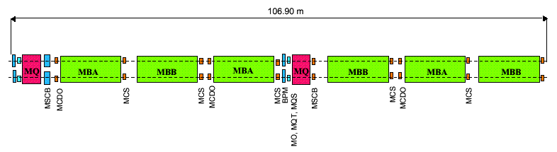
FODO cell
beta_y
beta_x
MB lattice dipole MQ lattice quadrupole
MSCB lattice sextupole+orbit corrector MO lattice octupole
MQT trim quadrupole MQS skew trim quadrupole
MCDO spool-piece decapole-octupole MCS spool-piece sextupole

Slide 27
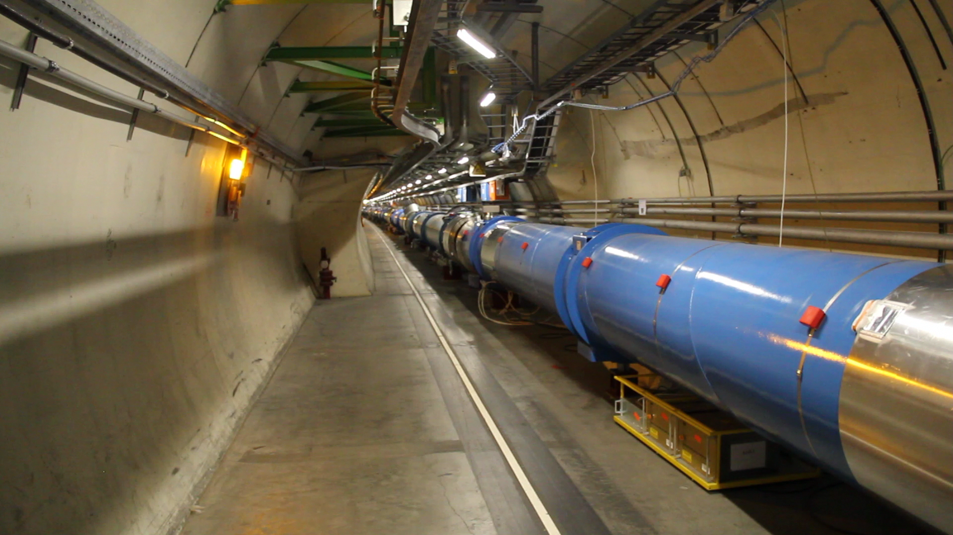
For real
Video 1’22’’

Slide 28
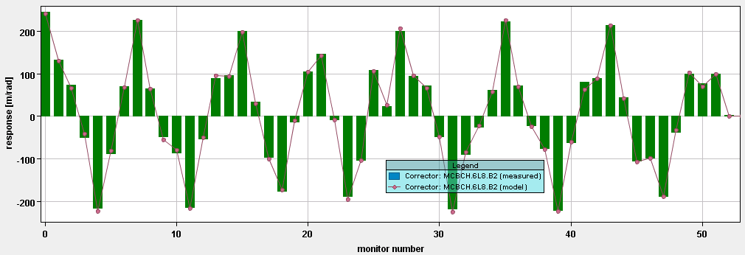
Betatron oscillations
Typical beam position monitor does not resolve individual particles.
However, if the beam is deviated from the ideal trajectory it will oscillate due to the (de)-focusing fields of the accelerator.
NB: single pass

Slide 29
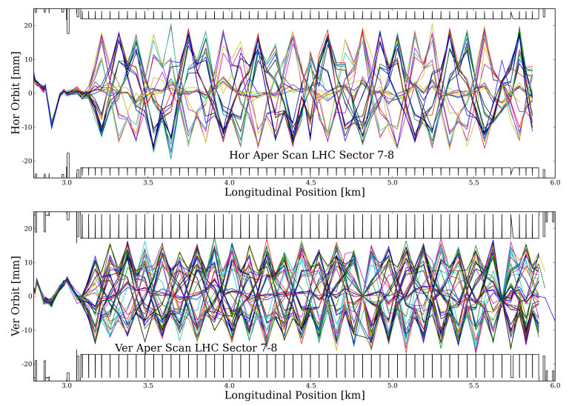
Injection test – 5 years ago

Slide 30
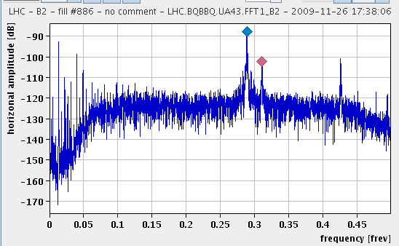
Tune
TUNE:
  number of betatron oscillations a particle makes in one turn of the ring
  Horizontal Q_{H} = 64.31
  Vertical Q_{V} = 59.32
Non-integer part is relevant for beam stability
Has to be controlled very carefully
Because like any other oscillator it can get into resonance…
LHC revolution frequency: 11.3 kHz

Slide 31
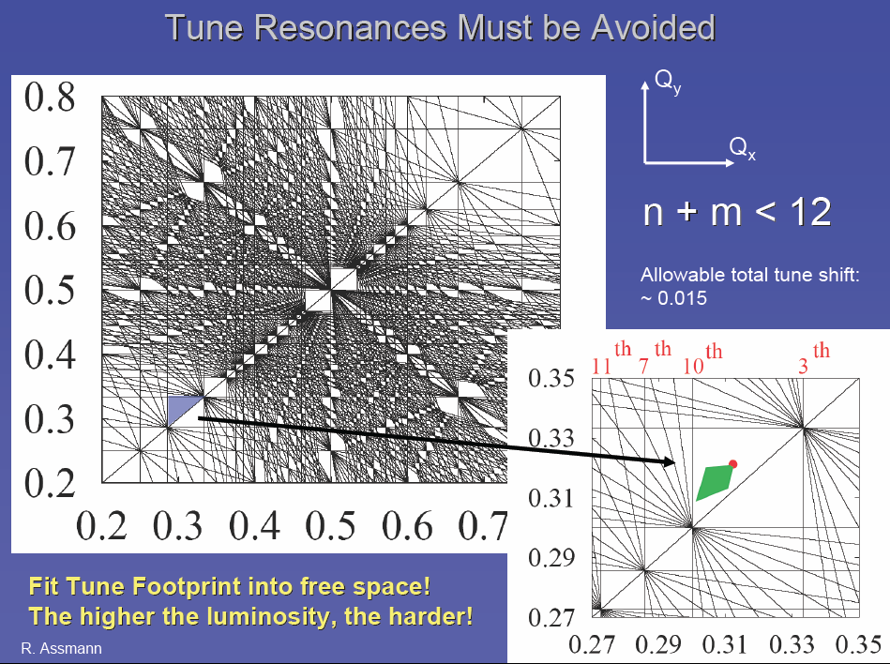

Slide 32
TRANSVERSE ACCELERATOR COORDINATES
We are discussing the paraxial (small deflection angles => linear), uncoupled (x & y independent) transverse motion of on-momentum particles around the design trajectory/orbit for a magnet lattice:
x’
x
s
(and similarly for y view)
s = coordinate along design orbit

Slide 33
Phase Space
x
x
1
1
2
s
4
4
2
3
3
x’
4
3
1
x
2

Slide 34
Phase space
Sit at a focusing quadrupole (for example) and plot the phase space coordinates of a single particle, it will describe an ellipse:
x’ [μrad]
t4
t3
t5
x [mm]
t6
t2
t1

Slide 35
Phase space
As we move around the ring the ellipse changes orientation BUT the area remains the same
x’
x’
x’
x
x
x

Slide 36
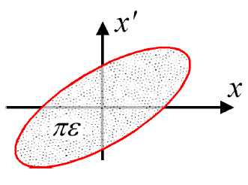
Emittance
Linear motion → beam ellipse in 2-d-space
Ellipse area in (x,x’) plane:
Define emittance by a contour confining some fraction of particles depending on distribution (typically Gaussian)
Units: mm.mrad (but you will see microns)
Imagine sitting at one location and plotting x,x’ of all particles
Or tracking one particle over many turns

Slide 37

Emittance
x’
Area of phase space ellipse = πε
x
σ
x

Slide 38

Normalized emittance
Geometric emittance {x,x’} shrinks naturally as we go up in energy
NB: relativistic β and ϒ!
Important – it’s energy independent and can be used across the accelerator complex and will show up later in a useful formulation of luminosity
Beta [m] | Sigma 450 GeV [micron] | Sigma 7 TeV [micron]
180 | 967 | 246
30 | 395 | 100
4000 | 4566 | 1158
0.6 | 56 | 14
Normalized emittance | 2.5 mm.mrad
Emittance 450 GeV | 5.2 nm.rad
Emittance 7000 GeV | 0.34 nm.rad

Slide 39

LHC beam envelope
1 sigma envelope – 68.3% of particles assuming a Gaussian distribution
4 TeV
ε_{n}=2.5 and 3.75 microns
mm
IP5

Slide 40


Phase space
Simulation showing the chaotic effect of the beam–beam interaction
Phase space trajectories near the septum of a compact synchrotron during low extraction

Slide 41
Magnet - basic arsenal
Dipole; constant field:
Quad; linear variation:
Sext.: quadratic variation:
By
By
x
x
By
x

Slide 42

Dispersion
Closed orbit for p < p₀
Closed orbit for p > p₀
Closed orbit for p=p₀

Slide 43

Dispersion at LHC
HORIZONTAL
VERTICAL
Beam size affected
Between an arc and the straight section there is the so-called dispersion suppressor that brings the dispersion function to zero in the straight section in a controlled way.

Slide 44
Chromaticity
A particle with a higher momentum than nominal will be deviated less in the quadrupole and will have a lower betatron tune
A particle with a lower momentum than nominal will be deviated more in the quadrupole and will have a higher betatron tune
→ spread in the tunes
due to spread in momentum
Rende Steerenberg

Slide 45
Chromaticity
x
And we have dispersion…

Slide 46
Chromaticity correction
with sextupoles
F_{x}
QD
QF
QD
QF
QF
SD
SF
SD
SF
SF

Slide 47


Slide 48
LHC Injector Cycling
To LHC clock-wise or counter clock-wise
= Field in main magnets
= Proton beam intensity (current)
= Beam transfer
450 GeV
SPS
26 GeV
PS
1.4 GeV
PSB
Time
1.2 seconds

Slide 49



The LHC 25 ns cycle in the PS
γ_{tr}
Inject 4+2 bunches
Eject 72 bunches
(sketched)
h = 7
h = 21
h = 84
Triple splitting after 2nd injection
Split in four at flat top energy
2nd injection
1.4 GeV
26 GeV/c
→ Each bunch from the Booster divided by 12 → 6 × 3 × 2 × 2 = 72

Slide 50

LHC bunch structure - 2012
50 ns bunch spacing
Maximum bunch intensity 1.7 x 10¹¹ protons per bunch
1 PS batch
(36 bunches)
1 SPS batch
(144 bunches)
Abort gap
26.7 km 1380 bunches

Slide 51

From the control room

Slide 52
A bunch
Number of protons | Up to 1.7 x 10¹¹ so far
Transverse beam size (1 sigma) at IP5 | 18.8 microns (4 TeV, β* = 60 cm.)
Transverse beam size (1 sigma) in arc | .97/.4 mm (450 GeV 2012)
Bunch length (4 sigma) | 1.25 ns (37.5 cm) in 2012
Momentum spread (1 sigma) | 1.129 x 10⁻⁴ i.e. ± 0.8 GeV 7 TeV (design report)

Slide 53

Interaction region
D2

Slide 54

In the long straight section
Video 1’57’’

Slide 55


Crossing angle
work with a crossing angle to avoid parasitic collisions.
generates additional tune shift
requires larger triplet magnet aperture
breaks symmetry between x,y planes
odd order resonances are exited
couples longitudinal and transverse motion
breaks the bunch symmetry
lowers available luminosity

Slide 56

Crossing and Separation Bumps
Collapse the separation bump (vertical in CMS) after the squeeze to bring the beams into collision
CMS
Crossing angle bump (Horizontal in CMS)
110 m

Slide 57

In practice
HORIZONTAL
VERTICAL
+/- 6 mm at 450 GeV

Slide 58

Squeeze in ATLAS
x´
x
β_{max} ~4.5 km
β* = 60 cm
NB: round beams at IP
Image courtesy John Jowett

Slide 59

Beam - Squeeze
Small beam in the IP → big beams in the inner triplets → reduced aperture
Therefore inject & ramp with bigger beam sizes at IP.

Slide 60


Squeeze
Going to use quadrupoles both sides of a given IP all the way out to the arc to control the optics during the squeeze.
Current in the inner triplets doesn’t actually change very much during the squeeze – but the beam size does.
TRIPLET
Long straight section
SEPARATION
DIPOLES
IP1
Dispersion suppressor

Slide 61

Triplet
Video 58’’

Slide 62
Program…
Today
  Dipoles, cryogenics, QPS
  Optics and basic beam parameters
  Beam configuration
  Interaction region layout
  Crossing angle and separation bumps
  Squeeze
Tomorrow
  Getting operational
  Without doing any damage (machine protection)

